Slide 1
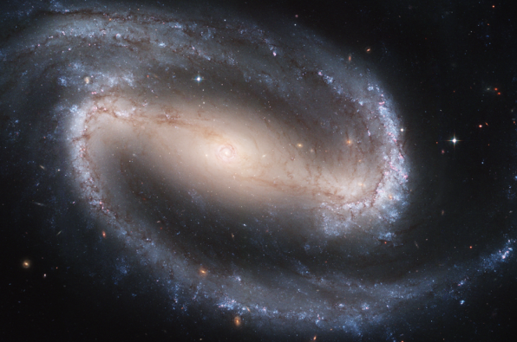
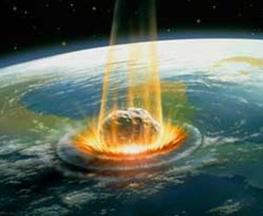
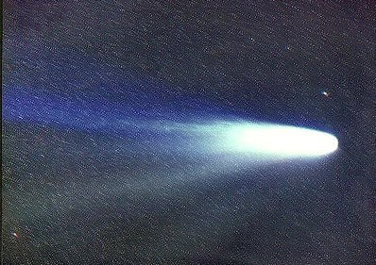
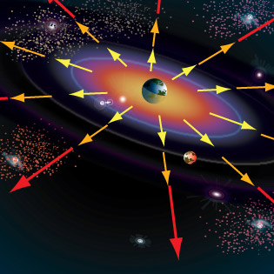
Galaxies, Other Objects and the Expansion of the Universe
Types of Galaxies
Asteroids
Meteors, Meteoroids, and Meteorites
Comets
The expansion of the Universe

Slide 2
Galaxies
Using a system invented by Edwin Hubble, astronomers classify galaxies into three major types:
Spiral
Elliptical
Irregular

Slide 3
Galaxies
The sizes of the three types span a wide range, from
Dwarf galaxies
which contain 100 million (10⁸) stars
to
Giant galaxies
which contain 1 trillion (10¹²) stars

Slide 4
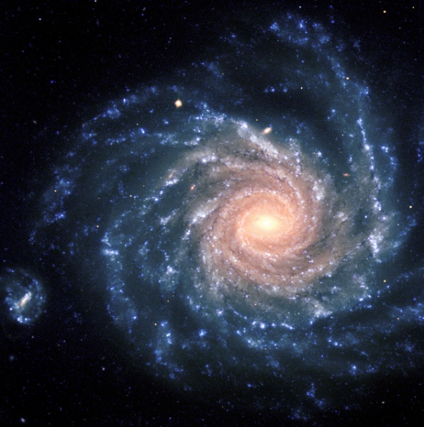
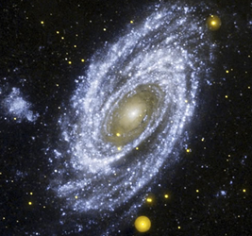
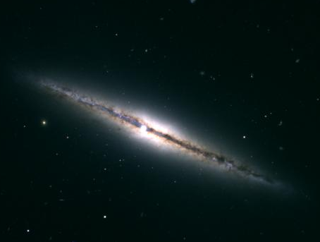
Spiral Galaxies
Look like a pinwheel from above
Looks like a plate with a bulge from the side
Has many long “arms” spiraling out from the centre
Middle aged stars
Middle amount of free gas and dust

Slide 5
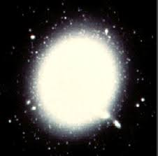
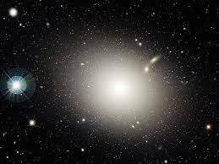
Elliptical Galaxies
Range in shape from a perfect sphere to a stretched-out ellipse
Contain some of the oldest stars in the universe
Most common type of galaxy
Very little free gas and dust

Slide 6
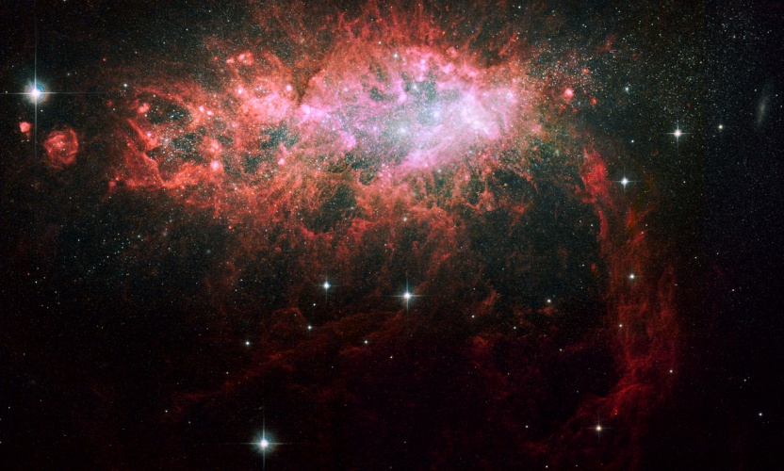
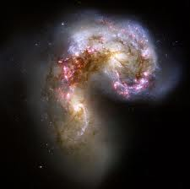
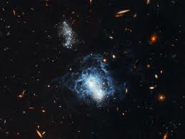
Irregular Galaxies
A “none of the above” category; neither spiral nor elliptical
Are made up of newly forming stars as well as old stars
Lots of free gas and dust

Slide 7
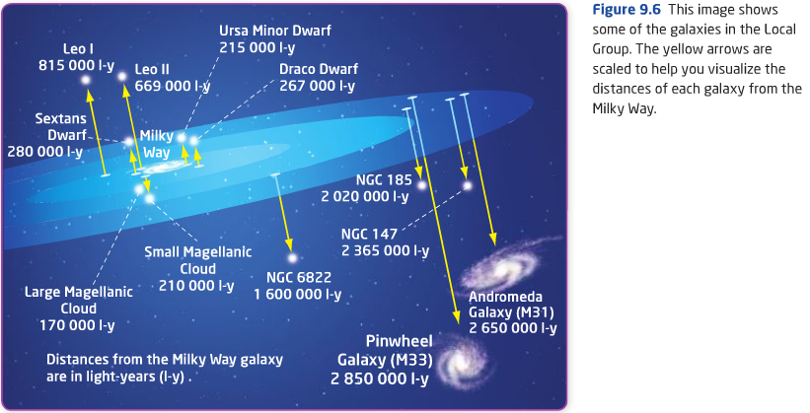
The Local Group
We combine galaxies into groups based on location
The Milky Way belongs to a group of about 40 Galaxies called the Local Group
The diameter of the Local Group is about 10 million light years across

Slide 8
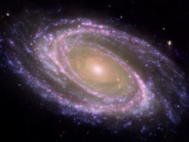
There are 24 galaxies in the universe for every person living on Earth!
**Note: images are not to scale**
Galaxies of the Universe

Slide 9
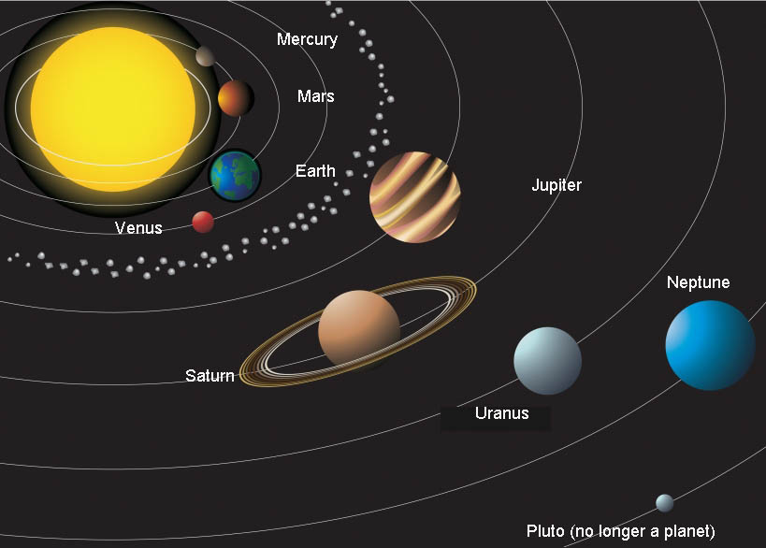
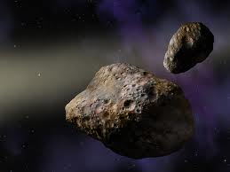
Other Objects In The Solar System
Asteroids
Small rocky objects that orbit the Sun
Thousands of small rocky objects in a ring is called the ASTEROID BELT (Between Mars and Jupiter)

Slide 10
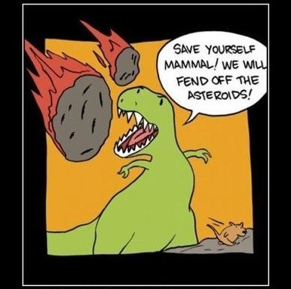
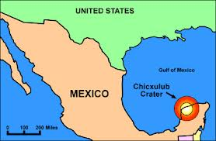
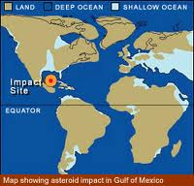
Asteroids
Size ranges from 6 meters to 933 km
Dinosaur killer ~ 10 km across
Landed near the Gulf of Mexico
Asteroid Impact – Dinosaur Killer

Slide 11
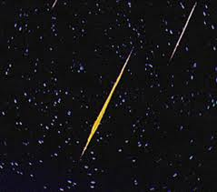
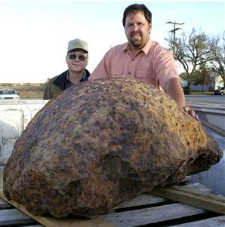
Meteors and Meteorites
Meteoroid is a lump of rock of metal that is pulled down by Earth’s gravity
Generally a small asteroid that has broken up or debris left behind by a comet
A Meteor is a bright streak of light across the sky as a meteoroid burns up.
Meteorite is a large meteoroid that doesn’t completely burn up in the atmosphere therefore, hitting the Earth and producing a larger crater.

Slide 12
February 2013 Meteor Explosion over Russia
The Meteor had an initial mass of about 12,000–13,000 metric tones (heavier than the Eiffel Tower), and measured between 17 and 20 meters in size (65 feet).
It was moving at approximately 18.6 km/s (over 41,000 mph or 66,960 km/h), almost 60 times the speed of sound.
It exploded 23.3 km above the ground releasing 500 kilotons of TNT, 20–30 times more energy than was released from the atomic bomb detonated at Hiroshima but without the radiation.
The explosion injured thousands due to the release of energy which created a shockwave shattering windows and topping smaller structures.

Slide 13
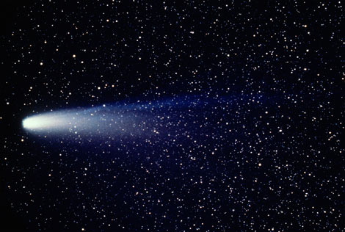
Comets
Chunk of frozen matter (usually ice) that travels in a very long orbit around the sun.
Comets have tails a few million km long
When the comet approaches the sun, it is warmed. Frozen substances become gases, which are then pushed outward by solar wind to produce a bright tail.

Slide 14
Bill Nye – Comets and Meteors

Slide 15
The Big Bang Theory
The Universe started out as an extremely compact, small and unimaginably dense structure
The Universe began expanding 14 Billion Years ago until it reached its present state

Slide 16
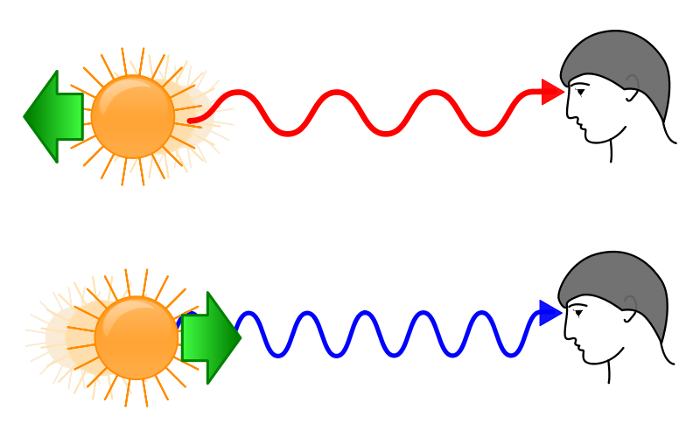
The Universe is Still Expanding
We know this due to the phenomenon known as red and blue shift.
When objects are moving away at a fast rate, they appear red. When they are moving towards you quickly, they appear blue.
We observe most galaxies are moving away from a central point (origin of the Universe?).
Red and Blue Shift

Slide 17
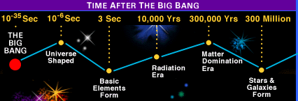
The Universe Timeline

