Slide 1
7th Grade Earth Science Julie Nelson
The curriculum is based on the Washington state science standards

Slide 2
7th Grade Science Units
Sun Earth Moon System
Phases of the Moon and Eclipses
Matter, Mass and Density
The Atmosphere
Weather Factors
Air Masses and Fronts
The Water Cycle and Clouds
Inside the Earth
Plate Tectonics
Earthquakes and Volcanoes
The Rock Cycle
Earth’s History
The Solar System
Investigations (all year)

Slide 3
Unit Format
Unit calendars (examples on desks) are handed out at the beginning of the unit with the unit review guide.
All unit assignments are in the pink bin and on-line at the beginning of each unit.

Slide 4
Successful Students
Keep current on assignments.
Complete review guide with care and study it.
The test does not have any questions not covered in the review guide, and the review guide does not ask anything that is not asked on the test.

Slide 5
‘C’ work is what we do in class. These assignments teach the state standards and are practice for the test. Full points on ‘C’ work and test = a grade of 75%
‘B’ work. Student choose from a selection of assignments. Most need to be typed. Completion shows a higher mastery of the content and raises grade to a maximum of 85%.
‘A’ work. Student choose from a selection of assignments. Most need to be typed. Completion shows the highest mastery of the content and raises grade to a maximum of 100%.
Missing ‘B’ and ‘A’ work show as a zero in the grade book.

Slide 6
Class Website http://www.weebly.com/weebly/main.php

Slide 7
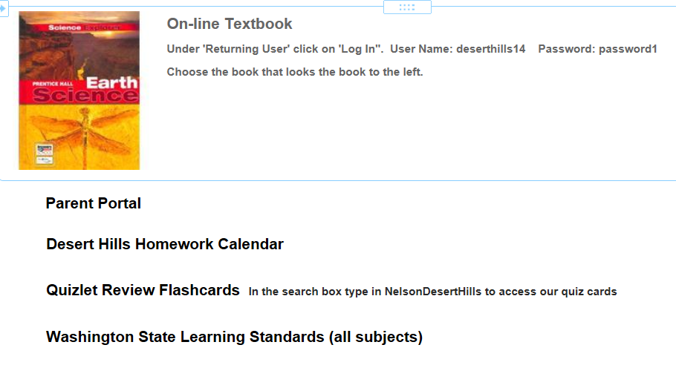
Links

Slide 8
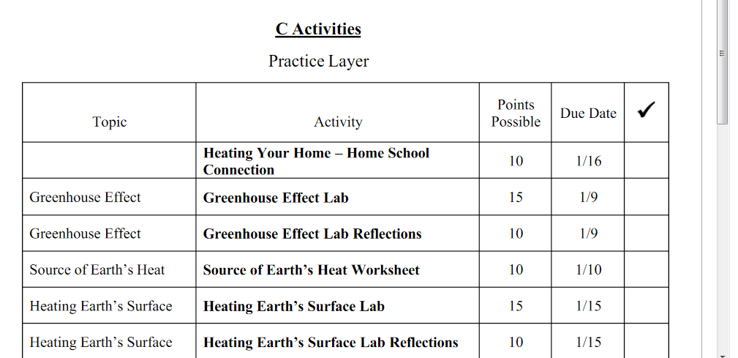
Current Unit Tab A scroll down list of assignments

Slide 9
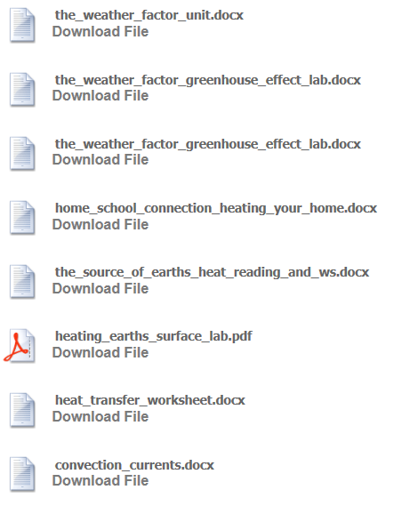
Current Unit Tab
The unit calendar and all (C, B and A) assignments are available to be downloaded.

Slide 10
Late and Make Up Assignments
Assignments are accepted until the last day of the unit (the day before the test). No more than one late assignment will be accepted per day, and the grade for late assignments will be reduced.
Make up tests: students have one day for every day of excused absence to make up a test. They may be made up before or after school or during lunch.
Missed labs: students have one week to make up labs. They may be done before or after school or on Tuesday during lunch.

